Slide 1
Secure Data Hiding in Image Using Steganography
CAPSTONE PROJECT
Presented By:
Srishti Shil
Vidyasagar University
Department of Computer Science

Slide 2
OUTLINE
Problem Statement
Technology used
Wow factor
End users
Result
Conclusion
Git-hub Link
Future scope

Slide 3
Problem Statement
In the digital communication era, securing sensitive information is vital. Traditional encryption methods can be vulnerable, and textual messages are easily intercepted. This project uses Python-based image steganography to embed secret messages within pixel values, ensuring hidden communication while preserving the image's integrity. The decryption process is password-protected for additional security.

Slide 4
Technology used
Programming Language: Python
Libraries Used:
OpenCV (cv2): For image processing and pixel manipulation
os: For file handling and system operations
Concepts Implemented:
Image Steganography: Hiding text messages within image pixel values
Encryption & Decryption: Securely encoding and retrieving messages
ASCII Encoding: Converting characters into numeric values for embedding
File Handling: Storing passwords and message lengths for retrieval

Slide 5
Technology used
System Requirements:
Operating System: Windows, macOS, or Linux
Processor: Minimum Intel Core i3 or equivalent
RAM: At least 4GB (8GB recommended)
Storage: Minimum 500MB of free space
Python Version: Python 3.6 or later
Required Libraries: OpenCV (cv2), OS (pre-installed with Python)

Slide 6
Wow factors
Secure Message Hiding – Utilizes image steganography to conceal messages within pixel values, making it nearly impossible to detect.
Password-Protected Decryption – Only users with the correct passcode can retrieve the hidden message, adding an extra layer of security.
Minimal Data Alteration – Embeds text without significantly altering the image, ensuring visual integrity is maintained.
Cross-Platform Compatibility – Works on Windows, macOS, and Linux with minimal system requirements.
Efficient Encoding & Decoding – Uses optimized algorithms to store and extract messages efficiently from images.
Lightweight & Fast – Requires only basic Python libraries, making it quick to execute without heavy dependencies.

Slide 7
End users
Army & Defense Sector – Secure military communication by embedding classified messages within images to prevent interception by adversaries.
Banking & Financial Systems – Protects sensitive financial data, such as transaction details and account information, by embedding them securely in images to prevent fraud and unauthorized access.
Government Intelligence Agencies – Enables covert operations by allowing confidential data exchange without detection.
Cybersecurity in Banking – Can be used to securely transmit encryption keys or authentication data without raising suspicion.
Law Enforcement & Counter-Terrorism Units – Helps in safely exchanging mission-critical information without exposing it to cyber threats.

Slide 8
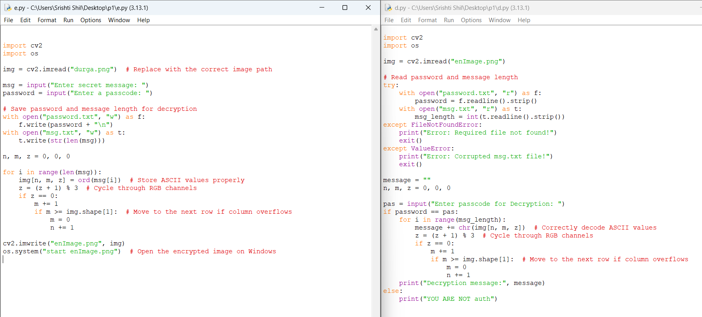
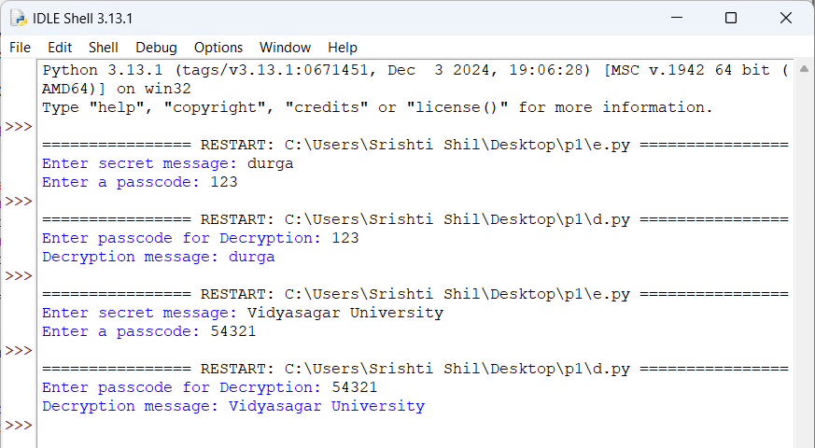
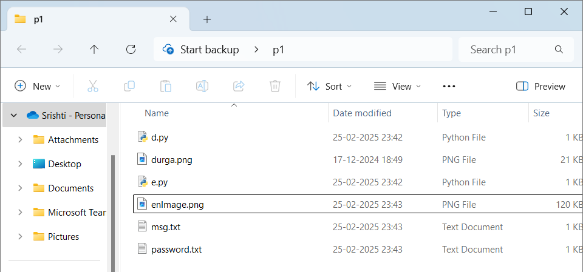
Results
Code:
Output:
Output files:

Slide 9
Conclusion
Conclude your project concerning your problem statement

Slide 10
GitHub Link
Make sure that there should be readme file

Slide 11
Future scope(optional)

Slide 12
THANK YOU

